Slide 1
An Improved Matching Score for SIFT
Presented By:-
Aakash Sharma 2K10/IT/001
Abhishek Jain 2K10/IT/002
Shikhar Verma 2K10/IT/061
Siddhant Jain 2K10/IT/064
Project Mentor:-
Mrs. Seba Susan

Slide 2
What is SIFT?
Scale-invariant feature transform ( SIFT) is an algorithm in computer vision to detect and describe local features in images. By local features we mean the features which are only restricted to a given image.
This algorithm focuses on identifying the features which are exclusive to a particular image, extracting them and finally storing them so that they can be used for object recognition in the given image.
Feature points are key points which provide a “feature description” of the image. Such points usually lie on high contrast regions of the image, such as object edges.

Slide 3
David Lowe’s Method
The SIFT algorithm proposed by David Lowe is an approach for extracting distinctive invariant features from images. This algorithm is invariant to image translation, scaling, rotation, partially invariant to illumination changes and robust to local geometric distortion.
This algorithm works in three stages:-
The first one is the extraction of salient feature points (for example corners) from both test and model object.
The second stage is the construction of regions around the salient points using mechanisms that aim to keep the regions characteristics insensitive to viewpoint and illumination changes.
The final stage is the matching between test and model images based on extracted features.

Slide 4
David Lowe’s Algorithm
Extraction of Salient features
The features location are determined as the local extrema of Difference of Gaussians (DOG Pyramid).
Keypoint Localization
The detected local extrema are localized by fitting a 3D quadratic function to the scale-space local sample point.
For each candidate keypoint, interpolation of nearby data is used to accurately determine its position which is done using the quadratic Taylor expansion of the Difference-of-Gaussian scale-space function, with the candidate keypoint as the origin.

Slide 5


Taylor Series expansion:
The location of the extremum, xcap , is determined by taking the derivative of this function with respect to and setting it to zero.
If it is larger than 0.5, then that means that the actual extremum lies closer to another keypoint and hence, the keypoint coordinates are replaced with new coordinates and the process is repeated.
Orientation Assignment
In this step each keypoint is assigned one or more orientations according to local image gradient. This helps in achieving rotation invariance.
Keypoint Descriptor
Previous steps found keypoint locations at particular scales and assigned orientations to them

Slide 6
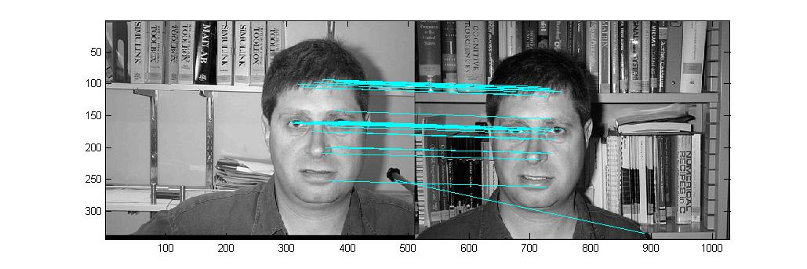
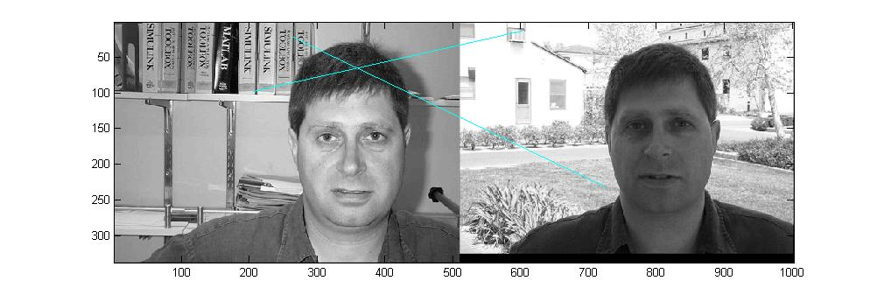
Results based on original SIFT
Figure 1
Figure 2

Slide 7
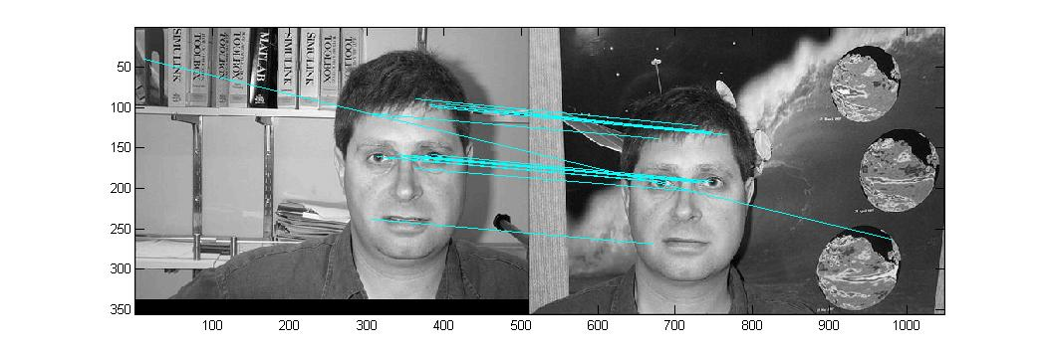
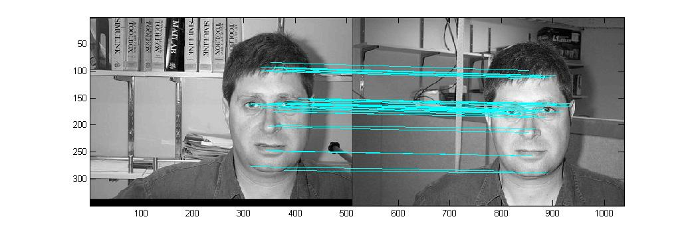
Figure 3
Figure 4

Slide 8
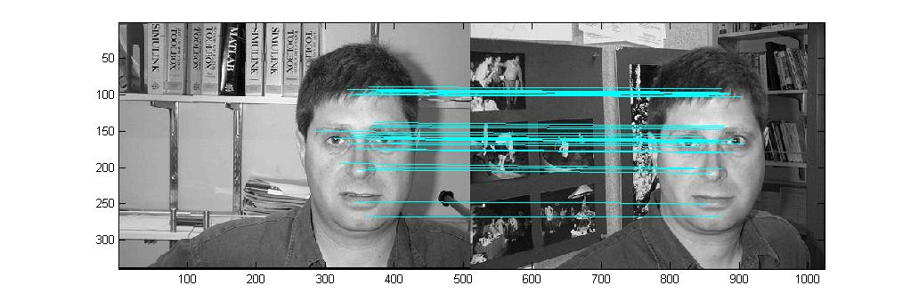
Figure 5
 | Number of Key points (Training Image) | Number of Key points (Test Image) | Matched Key points
Figure 1 | 744 | 1283 | 32
Figure 2 | 744 | 1112 | 2
Figure 3 | 744 | 838 | 20
Figure 4 | 744 | 613 | 38
Figure 5 | 744 | 1032 | 33

Slide 9
Improvements
The algorithm that we applied failed considerably as distortions due to strong 3d perspective effects couldn’t be handled.
For object with Limb like protrusions, parallax effect came into picture.
Also invariance with respect to brightness could not be achieved.
Thus, original SIFT algorithm proposed by David Lowe is not very accurate in detecting the faces because the amount of variation present in two same faces with different expressions is a lot.
We overhauled our approach to formulate a better algorithm which involved both David Lowe’s Algorithm and fuzzy techniques to improve our results.

Slide 10
Experiment
The first step is to calculate the number of keypoints in the images using the David Lowe’s Method
Then we calculate the Euclidian Distance between the keypoints using dot product and inverse cosine functions.
Then we find the absolute value of the angles between first and second nearest neighbor of the considered keypoint and stored in a vector.
This vector is evaluated for 1 test image with all 10 training images to generate a 2 dimensional vector.
After taking the first row of this 2-D vector, a column wise mean operation is done on the above vector which is concatenated by the extracted vector.
This concatenated vector is fed as input to the Shannon Entropy function.
where ci represents the value of the concatenated vector.

Slide 11
The calculation of H takes place for all rows of this 2 dimensional vector
The final Step of the experiment is to find the minimum entropy among the above evaluated entropies.
This minimum values of entropy gives the index of the training image whose keypoints have the least amount of randomness when matched with the test images’ keypoints.
The index found in the above step is the index image with which our test image has the most resemblance with.

Slide 12

















Face 1

Slide 13





Face 2

Slide 14





Face 3

Slide 15





Face 4

Slide 16





Face 5

Slide 17





Face 6

Slide 18





Face 7

Slide 19





Face 8

Slide 20





Face 9

Slide 21





Face 10

Slide 22
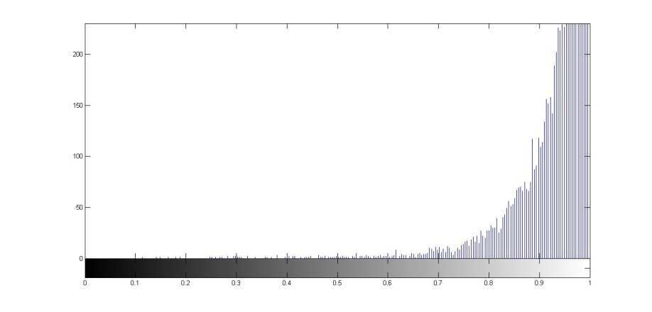
Conclusions
From the experiment conducted above we conclude the following things:
The matching achieved is less because the algorithm doesn’t consider all the keypoints present in both the images.
In the algorithm proposed by us, all the keypoints are considered for calculating the entropy. Therefore, better matching results are achieved.
Also, Shannon entropy gives a more accurate result than a non-extensive entropy because the amount of variation present in the values is very less and hence, there is a lot of randomness present in the images. This can be seen from the below histogram:

Slide 23
THANK YOU

